Slide 1
MCTE 3104 Mechatronics Interfacing Lab
Session no. 4 : Serial USB – UART communication

Slide 2
Outline
Serial Communication (USB <-> UART)
PC <-> Arduino
Raspi <-> Arduino
Serial Communication (Device UART <-> Device UART)
Arduino <-> Arduino
Serial UART Arduino Software Serial Library
Arduino <-> Bluetooth

Slide 3
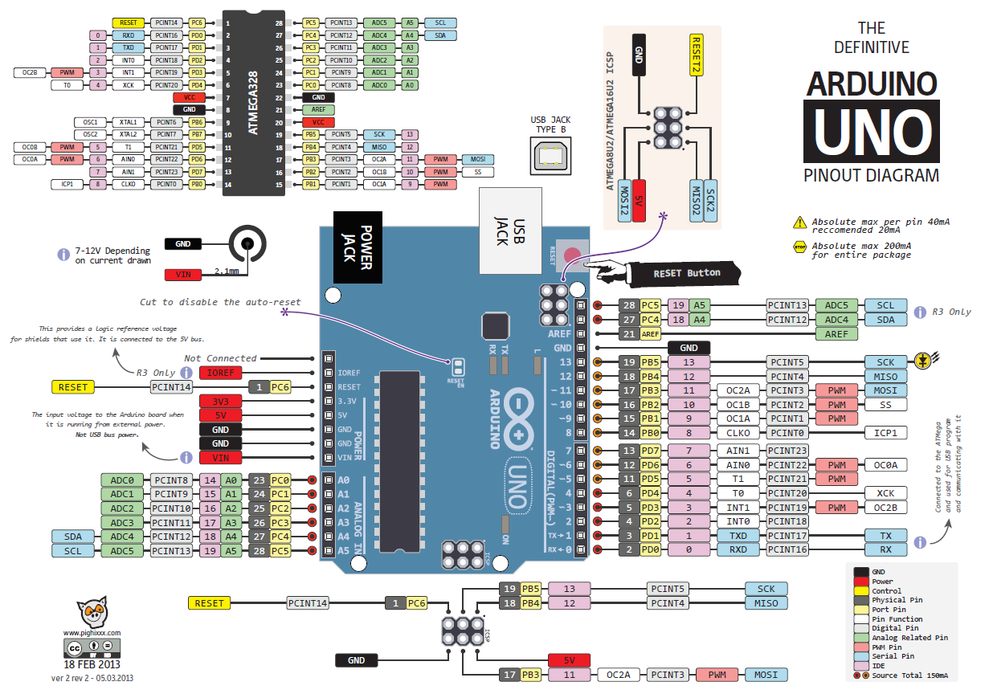

Slide 4
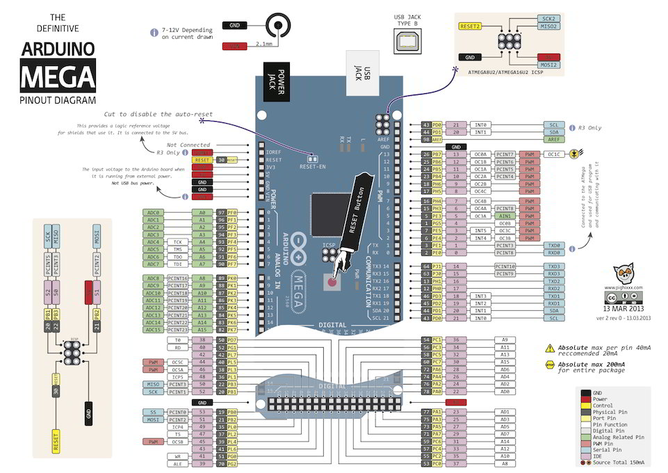

Slide 5
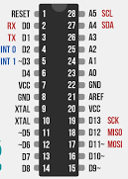

Typical device to PC interfacing
TX
RX
GND
USB-UART
converter
When a device is connected a ‘COM’ port is established at the PC

Slide 6
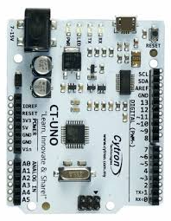
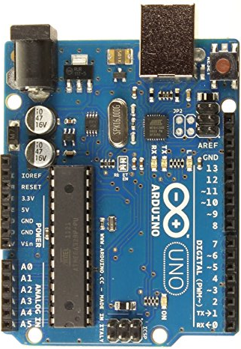
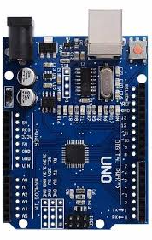
USB – UART Converter
FTDI - FT232RL
ATMEGA16U2
CH340G

Slide 7
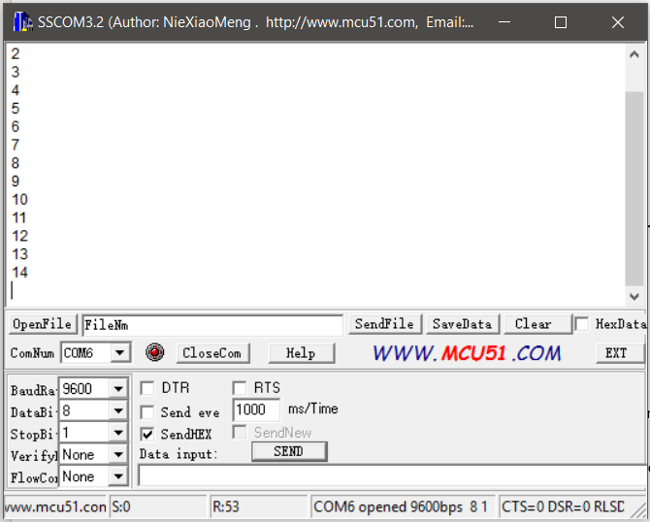
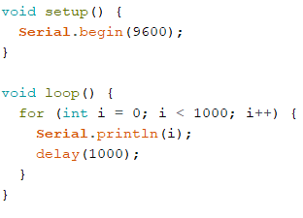
Example 1: Reading values from device on PC
You can access these established ‘COM’ port using free software such as TeraTerm, SSCOM32, etc..

Slide 8
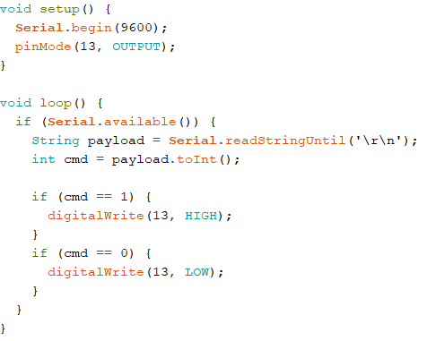
Example 2: Send command from PC to turn On and Off an LED attached to the Arduino
Since the Arduino is programmed to listen to the UART port and turns on on-board LED on when it receives ‘1’ and turns off on-board LED when it receives ‘0’.
You can send command ‘1’ or ‘0’ using free software such as SSCOM32 or write Python script to talk to the Arduino

Slide 9
Serial Communication
Lab activity 1:
Use SSCOM tool to send commands to the Arduino that will control servo movements.

Slide 10
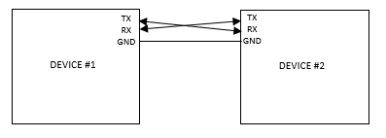
Typical device to Device (UART) – Device (UART) interfacing

Slide 11
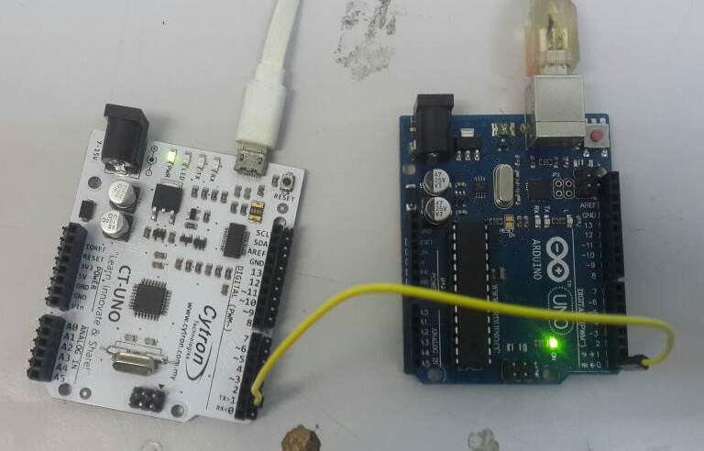
Simple device to Device (UART) – Device (UART) interfacing
Example 3:
Device #2
Device #1

Slide 12
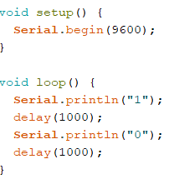
Simple device to Device (UART) – Device (UART) interfacing
Example 3: (continued)
Device #1
Device #2

Slide 13
Lab activity 2:
Connect two Arduinos (using UART lines) in such a way that Arduino 1 sends movement commands in degrees and Arduino 2 listens to it and moves a servo according to the command it receives.

Slide 14
Arduino SoftwareSerial Library
Since the Hardware UART chip is connected to 0 and 1 which also goes to the computer via USB connection often time we want to use this port for debugging purposes by displaying on the serial monitor.
SoftwareSerial library allows user to enable any digitial i/o pin to allow serial communication.
You can use this to allow UART communication to other devices

Slide 15
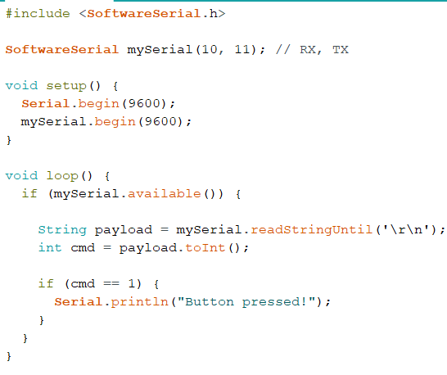
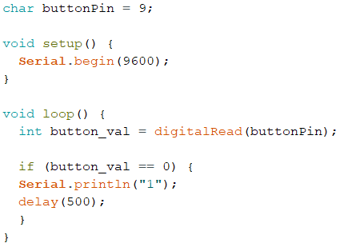
Arduino serial communication using softwareserial
Example 4:
Device #1
Device #2

Slide 16
Serial Communication
Lab activity 3:
Connect two Arduinos (using UART lines) in such a way that Arduino 1 reads a potentiometer value and transmit the value via the UART lines and Arduino 2 listens to it and display values on the serial monitor.

